Slide 1

371323864
372427616
377845128
Team Residuals
Movie Genre Prediction
March 24th 2021 Präsentiert von: Andras, Esther, Rainer, Thomas
Functional Colors
Red (Functional)
Yellow (Functional)
Green (Functional)

Slide 2
Agenda
Management Overview
Technical Details

Slide 3
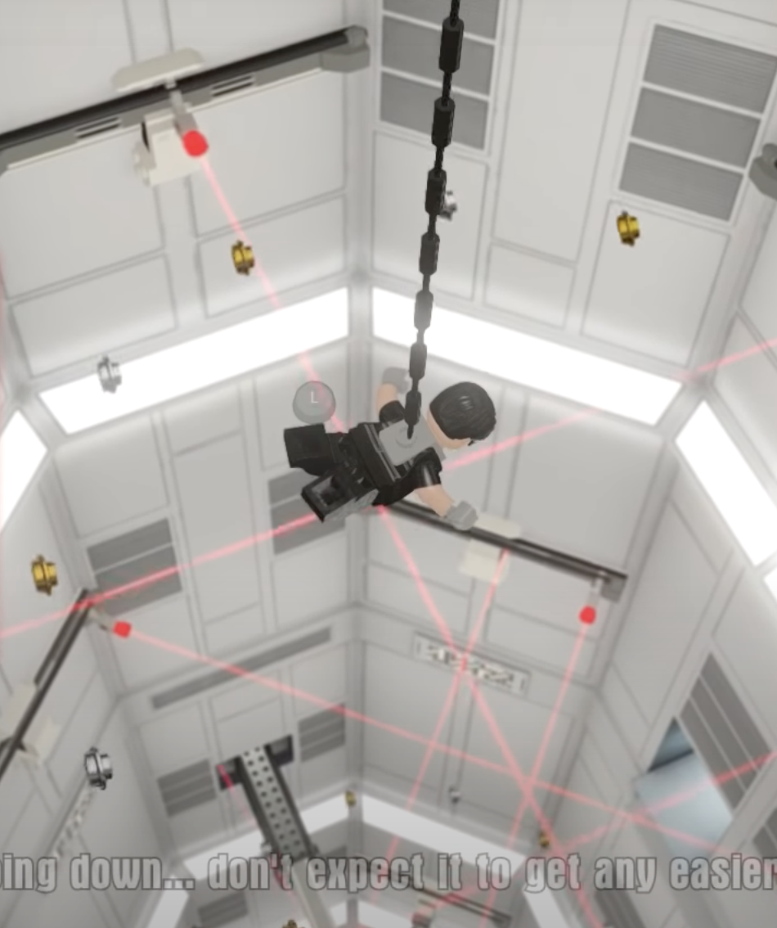

Mission
Mission: Create one model, which can predict the genre(art) of a given poster.
No matter the:
Size, release date or popularity
Find it !!!

Slide 4
Our Approach
Multilabel problem understanding
Unbalanced dataset in the meaning of genres
Size of the dataset was appropriate for using CNN models ~270.000 with valid image posters
Existing models (pretrained models) or creation of a new one and trained
We choose metrics that fits for this problem
https://kobiso.github.io/Computer-Vision-Leaderboard/imagenet.html
Notes:
Convolutional neural network which

Slide 5
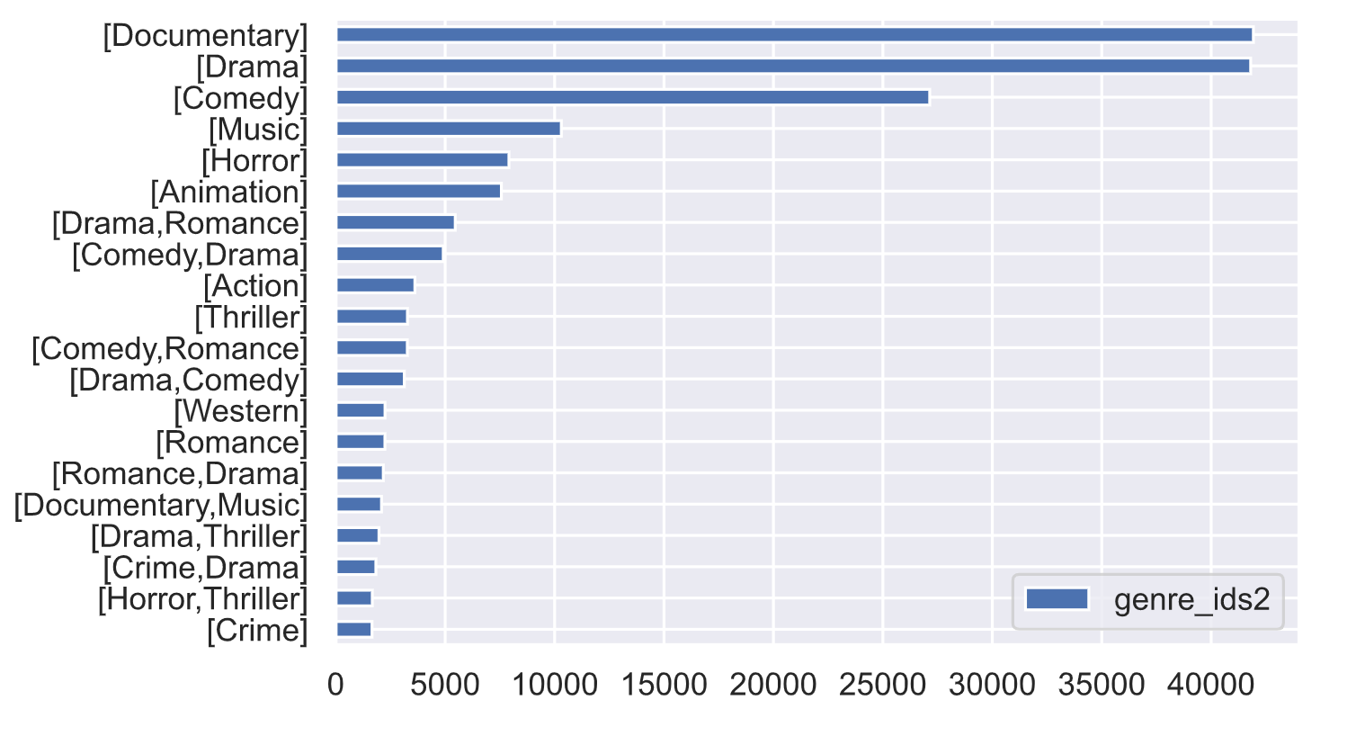
Multilabel problem understanding.
Top 20
Notes:
10066 multilabel combination

Slide 6
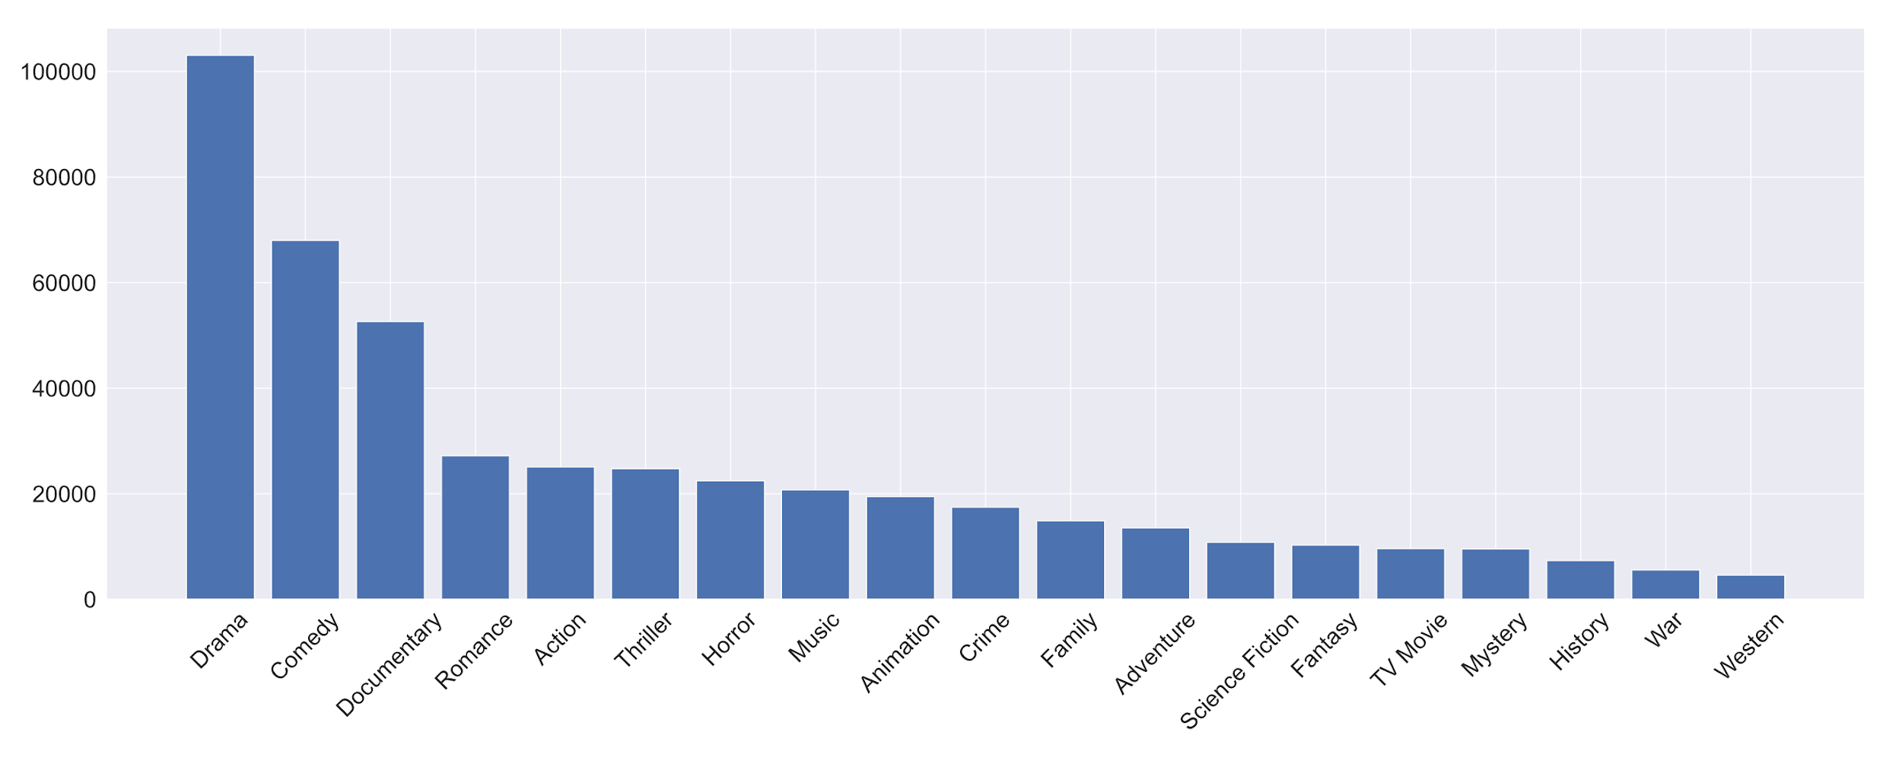



Unbalanced dataset in genres
Top 20

Slide 7
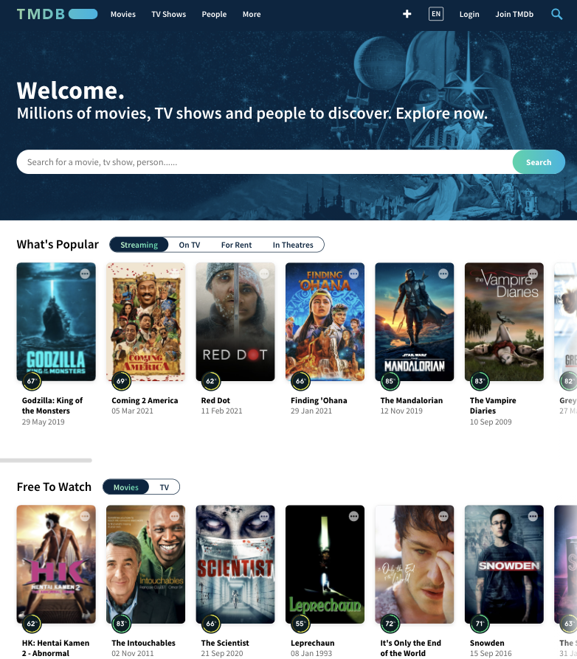


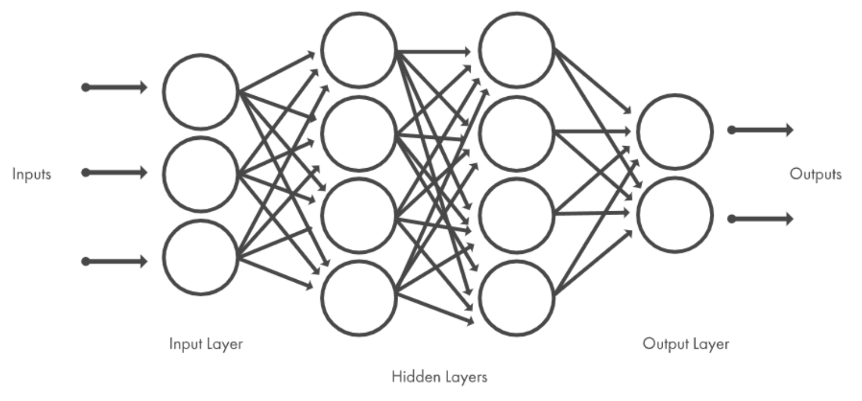





Size of the dataset
Aprox ~270.000 entries with valid posters images (21 GB)
The dataset size was appropriate for using CNN models
Notes:
For more detail in the technical approach

Slide 8

Metrics - F1 score validated
Notes:
F1.- Result

Slide 9
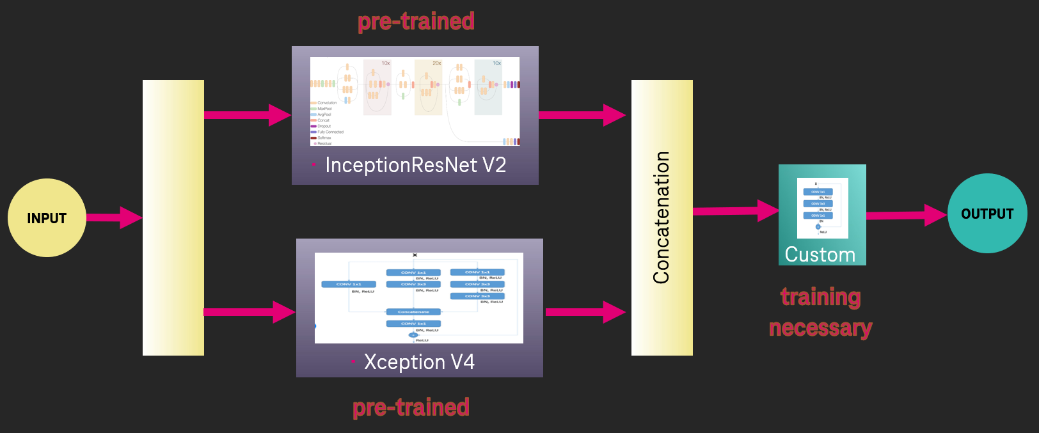
Using existing model or build up a new one?
Notes:
THOMAS
https://medium.com/@792/the-inceptionv3-experiment-a-shallow-sight-on-transfer-learning-74e8ef4a4533

Slide 10
Winner Model
Transfer-Learning Model (Inception ResNet V2.0 + Xception V4), pre-trained
Own Classificator Layers, trained -10 Epochs
Accuracy: 0.434 in test * and 0.514 in train
Training time: 2 Stunden
F1 Weighted Score:0.499 F1
F1 Micro Score 0.516
Notes:
https://www.researchgate.net/figure/Schematic-diagram-of-a-basic-convolutional-neural-network-CNN-architecture-26_fig1_336805909

Slide 11



Reality Check on favorite Movies of the team
Genres TMDb
Predicted
Action, Science Fiction
Action, Comedy, Science Fiction, Family
Drama, Thriller, Crime, Horror
Action, Science Fiction, Thriller
Action, Comedy, Science Fiction, Family
Drama,Thriller

Slide 12
Technical Details

Slide 13
Management of Artefacts
Git-Hub
Source code
Small data files (up to 25 MB)
Google-Drive
Movie posters (images) within ZIP archives
Presentation

Slide 14
Development
Python ML and Deep Learning Tools
Development Environments
Google Colab
Kaggle Notebooks and Dataframe
Local Jupyter Lab
Local Visual Studio Code

Slide 15
Preprocessing
Jupyter Notebooks
Using downloaded file for looping all movies of Movie-Poster-Database (TMDb)
Fetching movie metadata using the API of TMDb
Fetching movie posters (JPG images) via TMDb API
Storage of resulting data frames for train- and test sets in parquet files
Storage of images to Google-Drive and Kaggle dataset

Slide 16
Preprocessing
Cleaned train dataset without posters (unbalanced 273,876 rows / balanced 15,015 rows)
Categorical encoding of genres
Testset 1000 rows validated Missing images or genre Release-dates from 1924 to 2012

Slide 17
Data Quality
~500.000 Movies within TMDb
~270.000 with valid image posters (21 GB)
Movie release-dates from 1879 to 2030

Slide 18









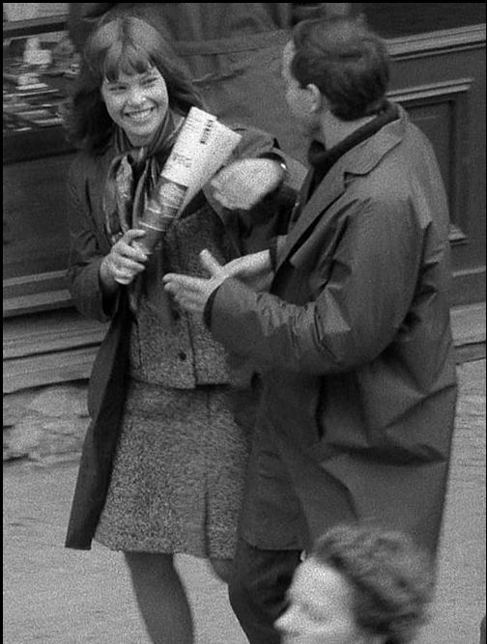
Poster Quality
Classic
Old fashioned
Strange
Music Event
Old fashioned too
Comic
Sports Event
No Picture
Picture only
Picture only

Slide 19
Modeling
Keras API
Keras ImageDataGenerator and Tensorflow Datasets Resized images e.g. 299x299x3 for transfer learning
Performance Issues in Colab and local environments
Experiment with Kaggle environment und Windows AI Server

Slide 20
Tested Models
* Threshold = 0.5
Model | F1 Weighted Score | F1 Micro Score | Training Set
Randomized (Threshold 0.5) | 0.079 | 0.076 | -
Simple CNN (baseline) | 0.395* | 0.346* | ~ 266.957
DenseNet (per Class Threshold) | 0.317* 0.510 | 0.363* 0.506 | ~ 266.957
Inception v3 | 0.344* | 0.382* | ~273.876
InceptionResNet V2 + Xception V4 + Custom (Threshold 0.25) | 0.375* 0.499 | 0.417* 0.516 | ~50.000 most popular
Notes:
Aussage zu Balancierung des Data Sets
ohne threshold *

Slide 21
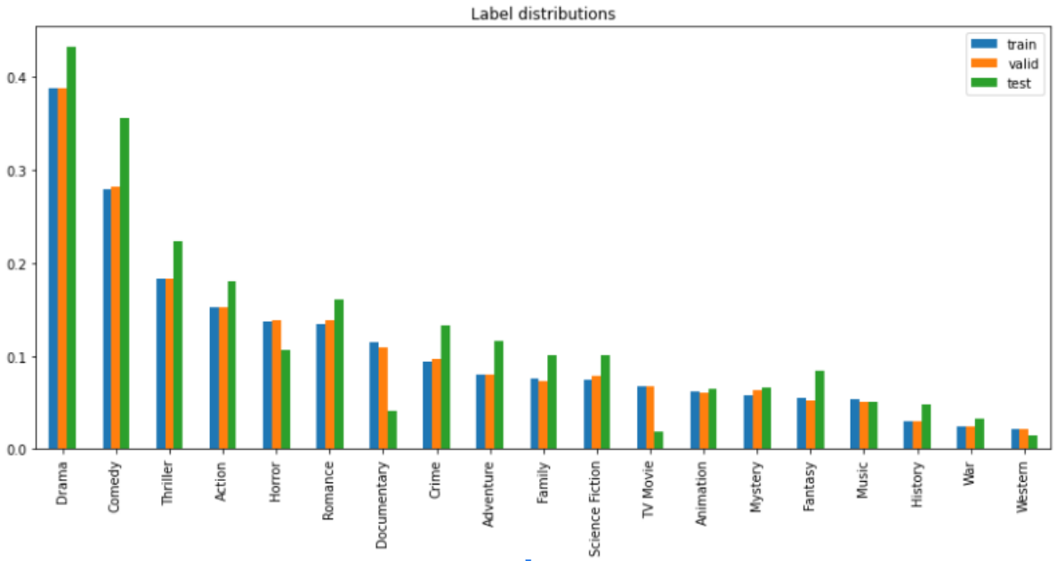
Examine the Poster distribution (unbalanced)
Notes:
First histogram -> multi label classification for all possible movies had the documentary in first place
Second histogram-> splitting the classes (without combination), we can see that drama becomes the first place follow by comedy
Third histogram (from andras solution)-> We tried different dataset to understand better the distribution of test and the metrics.

Slide 22
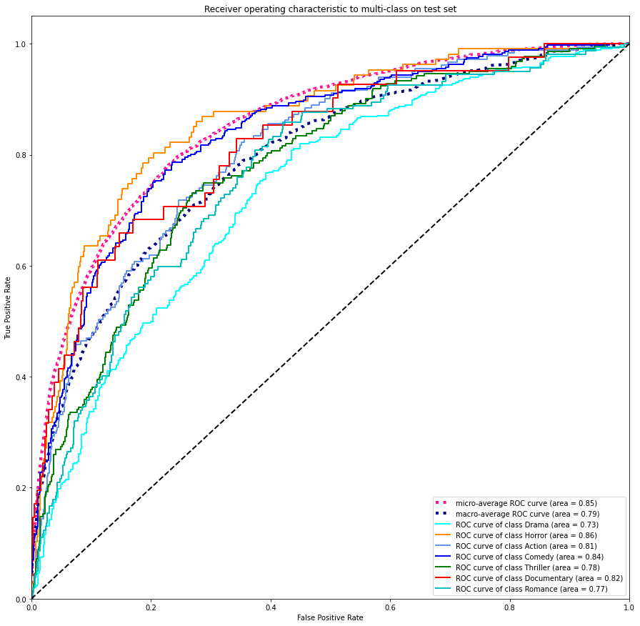
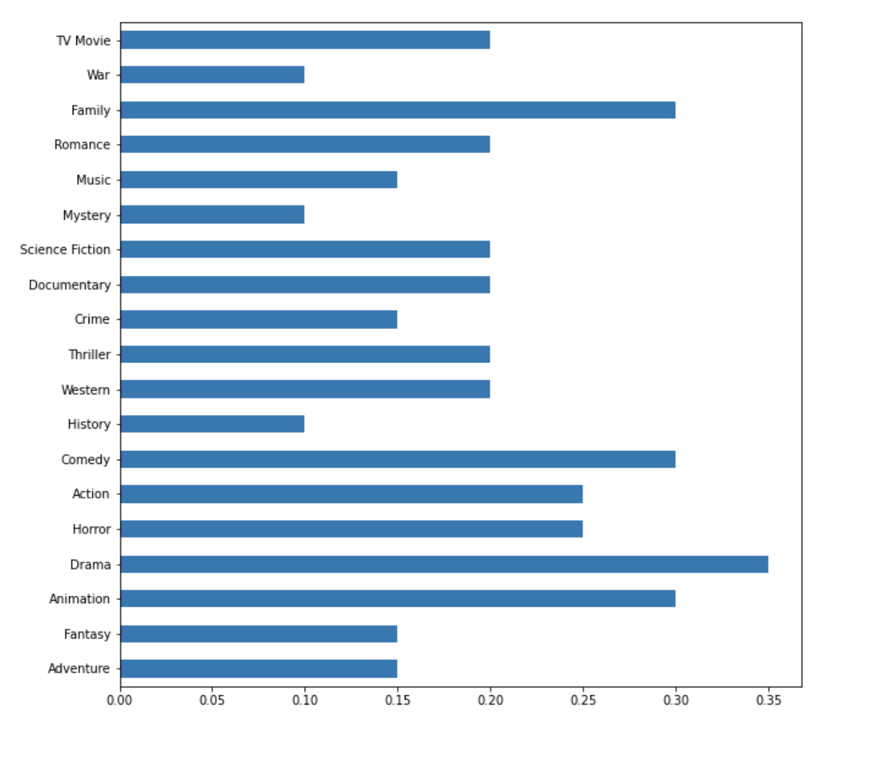
RoC curve and Thresholds (DenseNet)
Notes:
7 popular

Slide 23
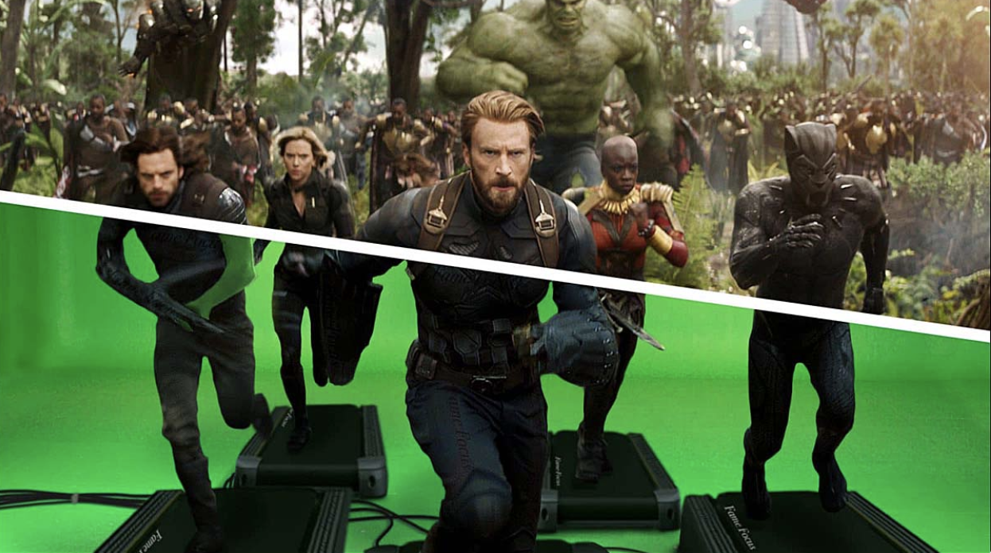
Where we run? / Kaggle
Kaggle Dataset for Images
Version in Background
Private Data 100 GB
GPU 41 hrs per week
TPU 30 hrs per week

Slide 24


Where we run? / AI Server
Remote Desktop
CPU: 2 x Intel® Xeon® CPU 55-2690 v4 @ 2.60GHz (28 cores) (all in all 56 logical processors)
RAM: 128 GB
GPU: 2 x NVIDIA Tesla K80 (11 GB), CUDA 11.2
Disks: 2 x DEL PERC H730 Mini SCSI Disk Device (149 GB, 1.74 TB)
OS: Windows Server 2019 Standard 64-bit

Slide 25
Results Performance Measurements
Test scenario: VGG16 Net, 2 epochs measured, 15k training sets, mirrored strategies
2 GPUs are 24 times faster than 56 CPUs
2 GPUs are 1.6 times faster than 1 GPU
2 GPUs are 1.5 times faster using tf.dataset (cached) instead of ImageDataGenerator for 1 GPU and CPUs there are no impact measured
Tensorboard callback does not slow down the training
NVIDIA Collective Communication Library (NCCL) not working

Slide 26
BACKUP

Slide 27
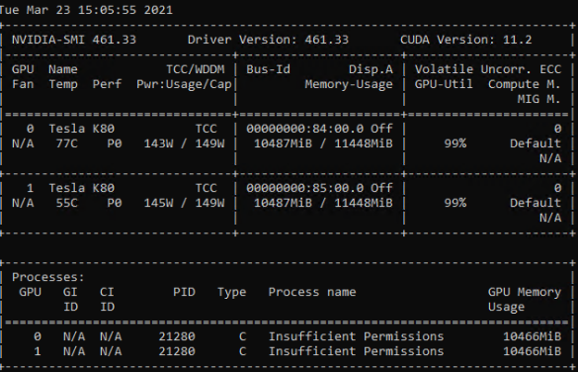
Usage of 2 GPUs on Win AI Server

Slide 28
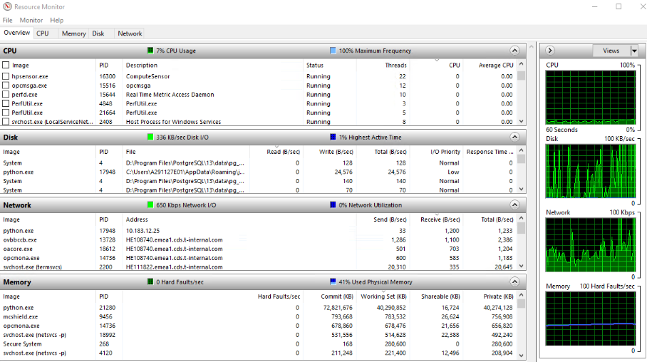
2 GPUs using tf.dataset (cached)

